Slide 1
CONTROLLING USER ACCESS
Oracle
Lecture 8

Slide 2
Objectives
After completing this lesson, you should be able to do the following:
  Differentiate system privileges from object privileges
  Grant privileges on tables
  View privileges in the data dictionary
  Grant roles
  Distinguish between privileges and roles
Notes:
Objectives
In this lesson, you learn how to control database access to specific objects and add new users with different levels of access privileges.

Slide 3


Controlling User Access
Database
administrator
Username and password
Privileges
Users
Notes:
Controlling User Access
In a multiple-user environment, you want to maintain security of the database access and use. With Oracle server database security, you can do the following:
Control database access
Give access to specific objects in the database
Confirm given and received privileges with the Oracle data dictionary
Create synonyms for database objects
Database security can be classified into two categories: system security and data security. System security covers access and use of the database at the system level such as the username and password, the disk space allocated to users, and the system operations that users can perform. Database security covers access and use of the database objects and the actions that those users can have on the objects.

Slide 4
Privileges
  Database security:
    System security
    Data security
  System privileges: Gaining access to the database
  Object privileges: Manipulating the content of the database objects
  Schemas: Collection of objects such as tables, views, and sequences
Notes:
Privileges
Privileges are the right to execute particular SQL statements. The database administrator (DBA) is a high-level user with the ability to create users and grant users access to the database and its objects. Users require system privileges to gain access to the database and object privileges to manipulate the content of the objects in the database. Users can also be given the privilege to grant additional privileges to other users or to roles, which are named groups of related privileges.
Schemas
A schema is a collection of objects such as tables, views, and sequences. The schema is owned by a database user and has the same name as that user.
For more information, see the Oracle Database10g Application Developer’s Guide – Fundamentals reference manual.

Slide 5
System Privileges
  More than 100 privileges are available.
  The database administrator has high-level system privileges for tasks such as:
    Creating new users
    Removing users
    Removing tables
    Backing up tables
Notes:
System Privileges
More than 100 distinct system privileges are available for users and roles. System privileges typically are provided by the database administrator.
Typical DBA Privileges

Slide 6
Creating Users
The DBA creates users with the CREATE USER statement.
CREATE USER user
IDENTIFIED BY password;
CREATE USER HR
IDENTIFIED BY HR;
User created.
Notes:
Creating a User
The DBA creates the user by executing the CREATE USER statement. The user does not have any privileges at this point. The DBA can then grant privileges to that user. These privileges determine what the user can do at the database level.
The slide gives the abridged syntax for creating a user.
In the syntax:
user is the name of the user to be created
Password specifies that the user must log in with this password
For more information, see Oracle Database10g SQL Reference, “GRANT” and “CREATE USER.”

Slide 7
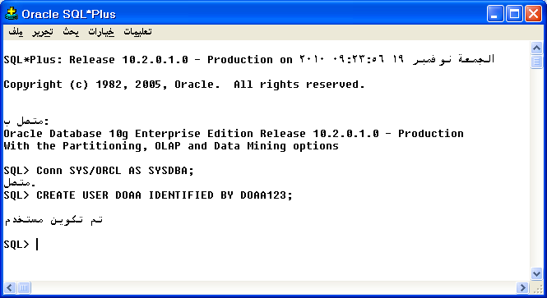
Creating Users

Slide 8
User System Privileges
  After a user is created, the DBA can grant specific system privileges to that user.
  An application developer, for example, may have the following system privileges:
    CREATE SESSION
    CREATE TABLE
    CREATE SEQUENCE
    CREATE VIEW
    CREATE PROCEDURE
GRANT privilege [, privilege...]
TO user [, user| role, PUBLIC...];
Notes:
Typical User Privileges
After the DBA creates a user, the DBA can assign privileges to that user.
In the syntax:
privilege is the system privilege to be granted
user |role|PUBLIC is the name of the user, the name of the role, or PUBLIC designates that every user is granted the privilege
Note: Current system privileges can be found in the SESSION_PRIVS dictionary view.

Slide 9
Granting System Privileges
The DBA can grant specific system privileges to a user.
GRANT create session, create table,
create sequence, create view
TO scott;
Grant succeeded.
Notes:
Granting System Privileges
The DBA uses the GRANT statement to allocate system privileges to the user. After the user has been granted the privileges, the user can immediately use those privileges.
In the example on the slide, user Scott has been assigned the privileges to create sessions, tables, sequences, and views.

Slide 10
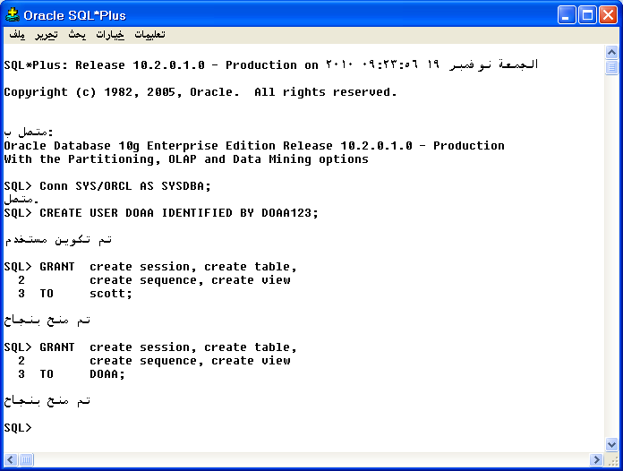
Granting System Privileges

Slide 11
What Is a Role?
Users
Manager
Privileges
Allocating privileges
without a role
Allocating privileges
with a role
Notes:
What Is a Role?
A role is a named group of related privileges that can be granted to the user. This method makes it easier to revoke and maintain privileges.
A user can have access to several roles, and several users can be assigned the same role. Roles are typically created for a database application.
Creating and Assigning a Role
First, the DBA must create the role. Then the DBA can assign privileges to the role and assign the role to users.
Syntax
CREATE ROLE role;
In the syntax:
role is the name of the role to be created
After the role is created, the DBA can use the GRANT statement to assign the role to users as well as assign privileges to the role.

Slide 12
Creating and Granting Privileges to a Role
  Create a role
  Grant privileges to a role
  Grant a role to users
CREATE ROLE manager;
Role created.
GRANT create table, create view
TO manager;
Grant succeeded.
GRANT manager TO DE HAAN, KOCHHAR;
Grant succeeded.
Notes:
Creating a Role
The example on the slide creates a manager role and then enables managers to create tables and views. It then grants De Haan and Kochhar the role of managers. Now De Haan and Kochhar can create tables and views.
If users have multiple roles granted to them, they receive all of the privileges associated with all of the roles.

Slide 13
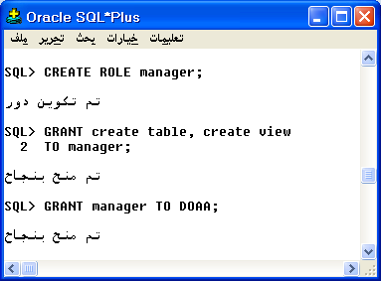
Creating and Granting Privileges to a Role

Slide 14
Changing Your Password
  The DBA creates your user account and initializes your password.
  You can change your password by using the ALTER USER statement.
ALTER USER HR
IDENTIFIED BY employ;
User altered.
Notes:
Changing Your Password
The DBA creates an account and initializes a password for every user. You can change your password by using the ALTER USER statement.
Syntax
ALTER USER user IDENTIFIED BY password;
In the syntax:
user is the name of the user
password specifies the new password
Although this statement can be used to change your password, there are many other options. You must have the ALTER USER privilege to change any other option.
For more information, see the Oracle Database10g SQL Reference manual.
Note: SQL*Plus has a PASSWORD command (PASSW) that can be used to change the password of a user when the user is logged in. This command is not available in iSQL*Plus.

Slide 15
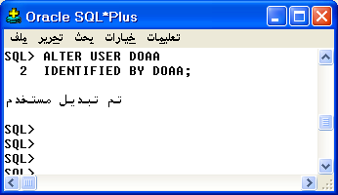
Changing Your Password

Slide 16
Object Privileges
Object
Privilege Table View Sequence Procedure
ALTER √ √
DELETE √ √
EXECUTE √
INDEX √
INSERT √ √
REFERENCES √
SELECT √ √ √
UPDATE √ √
Notes:
Object Privileges
An object privilege is a privilege or right to perform a particular action on a specific table, view, sequence, or procedure. Each object has a particular set of grantable privileges. The table on the slide lists the privileges for various objects. Note that the only privileges that apply to a sequence are SELECT and ALTER. UPDATE, REFERENCES, and INSERT can be restricted by specifying a subset of updatable columns. A SELECT privilege can be restricted by creating a view with a subset of columns and granting the SELECT privilege only on the view. A privilege granted on a synonym is converted to a privilege on the base table referenced by the synonym.

Slide 17
Object Privileges
  Object privileges vary from object to object.
  An owner has all the privileges on the object.
  An owner can give specific privileges on that owner’s object.
GRANT object_priv [(columns)]
ON object
TO {user|role|PUBLIC}
[WITH GRANT OPTION];
Notes:
Granting Object Privileges
Different object privileges are available for different types of schema objects. A user automatically has all object privileges for schema objects contained in the user’s schema. A user can grant any object privilege on any schema object that the user owns to any other user or role. If the grant includes WITH GRANT OPTION, then the grantee can further grant the object privilege to other users; otherwise, the grantee can use the privilege but cannot grant it to other users.
In the syntax:
object_priv is an object privilege to be granted
ALL specifies all object privileges
columns specifies the column from a table or view on which
privileges are granted
ON object is the object on which the privileges are granted
TO identifies to whom the privilege is granted
PUBLIC grants object privileges to all users
WITH GRANT OPTION enables the grantee to grant the object privileges to other users and roles

Slide 18
Granting Object Privileges
  Grant query privileges on the EMPLOYEES table.
  Grant privileges to update specific columns to users and roles.
GRANT select
ON employees
TO sue, rich;
Grant succeeded.
GRANT update (department_name, location_id)
ON departments
TO scott, manager;
Grant succeeded.
Notes:
Guidelines
To grant privileges on an object, the object must be in your own schema, or you must have been granted the object privileges WITH GRANT OPTION.
An object owner can grant any object privilege on the object to any other user or role of the database.
The owner of an object automatically acquires all object privileges on that object.
The first example on the slide grants users Sue and Rich the privilege to query your EMPLOYEES table. The second example grants UPDATE privileges on specific columns in the DEPARTMENTS table to Scott and to the manager role.
If Sue or Rich now want to use a SELECT statement to obtain data from the EMPLOYEES table, the syntax they must use is:
SELECT * FROM HR.employees;
Alternatively, they can create a synonym for the table and issue a SELECT statement from the synonym:
CREATE SYNONYM emp FOR HR.employees;
SELECT * FROM emp;
Note: DBAs generally allocate system privileges; any user who owns an object can grant object privileges.

Slide 19
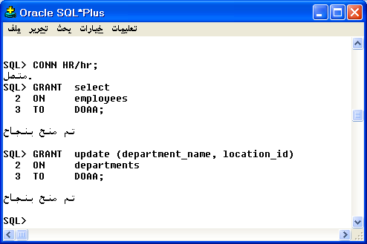
Granting Object Privileges

Slide 20
Passing On Your Privileges
  Give a user authority to pass along privileges.
  Allow all users on the system to query data from Alice’s DEPARTMENTS table.
GRANT select, insert
ON departments
TO scott
WITH GRANT OPTION;
Grant succeeded.
GRANT select
ON alice.departments
TO PUBLIC;
Grant succeeded.
Notes:
WITH GRANT OPTION Keyword
A privilege that is granted with the WITH GRANT OPTION clause can be passed on to other users and roles by the grantee. Object privileges granted with the WITH GRANT OPTION clause are revoked when the grantor’s privilege is revoked.
The example on the slide gives user Scott access to your DEPARTMENTS table with the privileges to query the table and add rows to the table. The example also shows that Scott can give others these privileges.
PUBLIC Keyword
An owner of a table can grant access to all users by using the PUBLIC keyword.
The second example allows all users on the system to query data from Alice’s DEPARTMENTS table.

Slide 21
Confirming Privileges Granted
Data Dictionary View Description
ROLE_SYS_PRIVS System privileges granted to roles
ROLE_TAB_PRIVS Table privileges granted to roles
USER_ROLE_PRIVS Roles accessible by the user
USER_TAB_PRIVS_MADE Object privileges granted on the user’s objects
USER_TAB_PRIVS_RECD Object privileges granted to the user
USER_COL_PRIVS_MADE Object privileges granted on the
columns of the user’s objects
USER_COL_PRIVS_RECD Object privileges granted to the user on specific columns
USER_SYS_PRIVS System privileges granted to the user
Notes:
Confirming Granted Privileges
If you attempt to perform an unauthorized operation, such as deleting a row from a table for which you do not have the DELETE privilege, the Oracle server does not permit the operation to take place.
If you receive the Oracle server error message “table or view does not exist,” then you have done either of the following:
Named a table or view that does not exist
Attempted to perform an operation on a table or view for which you do not have the appropriate privilege
You can access the data dictionary to view the privileges that you have. The chart on the slide describes various data dictionary views.

Slide 22
Revoking Object Privileges
  You use the REVOKE statement to revoke privileges granted to other users.
  Privileges granted to others through the WITH GRANT OPTION clause are also revoked.
REVOKE {privilege [, privilege...]|ALL}
ON object
FROM {user[, user...]|role|PUBLIC}
[CASCADE CONSTRAINTS];
Notes:
Revoking Object Privileges
You can remove privileges granted to other users by using the REVOKE statement. When you use the REVOKE statement, the privileges that you specify are revoked from the users you name and from any other users to whom those privileges were granted by the revoked user.
In the syntax:
CASCADE is required to remove any referential integrity constraints made to the CONSTRAINTS object by means of the REFERENCES privilege
For more information, see Oracle Database10g SQL Reference.
Note: If a user were to leave the company and you revoke his privileges, you must re-grant any privileges that this user may have granted to other users. If you drop the user account without revoking privileges from it, then the system privileges granted by this user to other users are not affected by this action.

Slide 23
Revoking Object Privileges
As user Alice, revoke the SELECT and INSERT privileges given to user Scott on the DEPARTMENTS table.
REVOKE select, insert
ON departments
FROM scott;
Revoke succeeded.
Notes:
Revoking Object Privileges (continued)
The example on the slide revokes SELECT and INSERT privileges given to user Scott on the DEPARTMENTS table.
Note: If a user is granted a privilege with the WITH GRANT OPTION clause, that user can also grant the privilege with the WITH GRANT OPTION clause, so that a long chain of grantees is possible, but no circular grants are permitted. If the owner revokes a privilege from a user who granted the privilege to other users, then the revoking cascades to all privileges granted.
For example, if user A grants a SELECT privilege on a table to user B including the WITH GRANT OPTION clause, user B can grant to user C the SELECT privilege with the WITH GRANT OPTION clause as well, and user C can then grant to user D the SELECT privilege. If user A revokes privileges from user B, then the privileges granted to users C and D are also revoked.

Slide 24
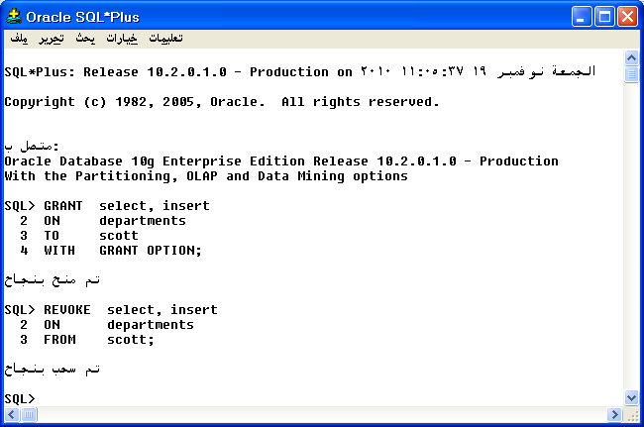
Revoking Object Privileges

Slide 25
Summary
In this lesson, you should have learned about statements that control access to the database and database objects.
Statement Action
CREATE USER Creates a user (usually performed by a DBA)
GRANT Gives other users privileges to access the objects
CREATE ROLE Creates a collection of privileges (usually performed by a DBA)
ALTER USER Changes a user’s password
REVOKE Removes privileges on an object from users
Notes:
Summary
DBAs establish initial database security for users by assigning privileges to the users.
The DBA creates users who must have a password. The DBA is also responsible for establishing the initial system privileges for a user.
After the user has created an object, the user can pass along any of the available object privileges to other users or to all users by using the GRANT statement.
A DBA can create roles by using the CREATE ROLE statement to pass along a collection of system or object privileges to multiple users. Roles make granting and revoking privileges easier to maintain.
Users can change their password by using the ALTER USER statement.
You can remove privileges from users by using the REVOKE statement.
With data dictionary views, users can view the privileges granted to them and those that are granted on their objects.
With database links, you can access data on remote databases. Privileges cannot be granted on remote objects.

